Slide 1


JSON - Storing Data
When storing data, the data has to be a certain format, and regardless of where you choose to store it, text is always one of the legal formats.
JSON makes it possible to store JavaScript objects as text.
Java script object
Client
Java script object

Slide 2
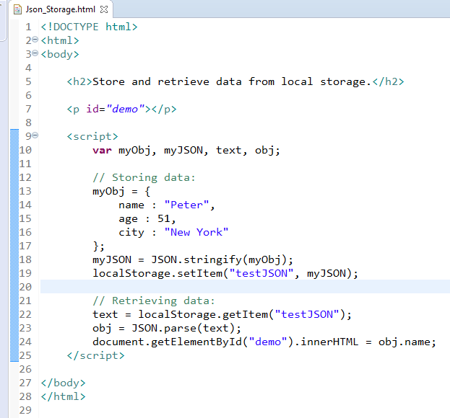
JSON - Storing Data

Slide 3
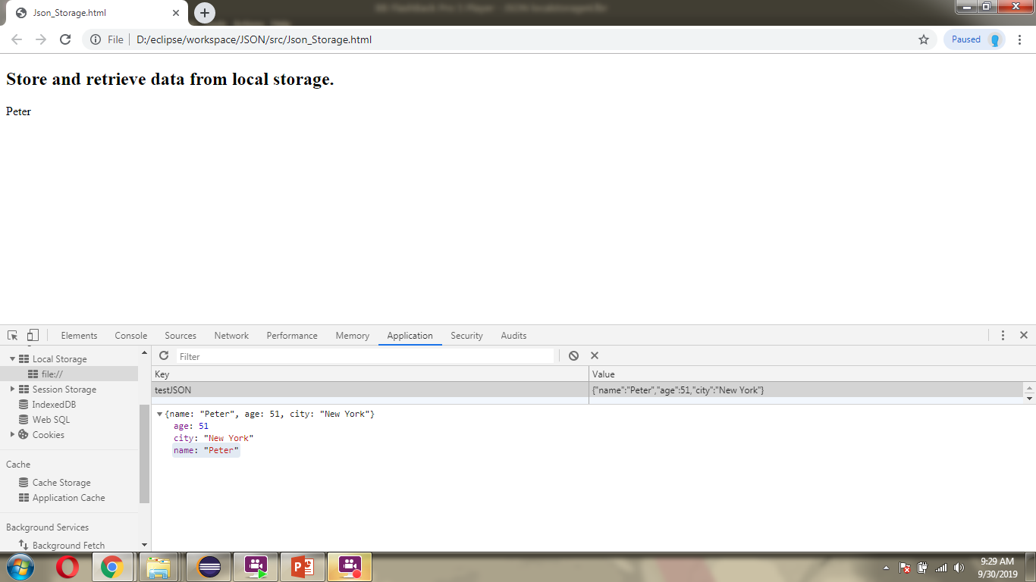
JSON - Storing Data

